Slide 1
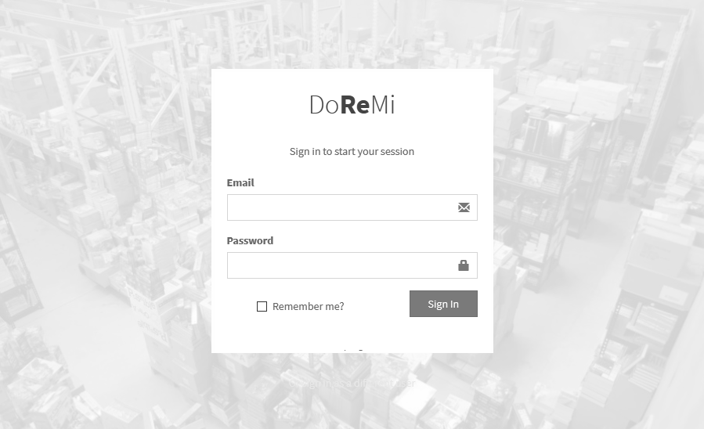
DoReMi
Online Order Management System
(User Guide v1.3)

Slide 2
CONTENTS
How to Sign On to the system
2
Dashboard – Chart Summary
3
Customer Master
6
EDIT AN EXISTING CUSTOMER RECORD
7
ADD A NEW CUSTOMER RECORD
8
Add a New Sales Order
9
Event Logs
11
Change Password
12
Sales User – Confirms a Sales Order
13
Packing Team User – “Packing” Status
14
A Typical Event Log for a Standard Sales Order
15
When a Sales Order QTY Exceeds the Inventory Stock’s Balance
16
Key Contact Persons
17
Page 1

Slide 3
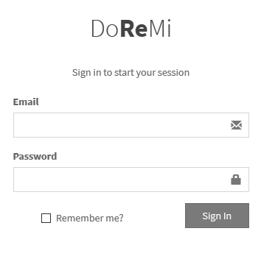
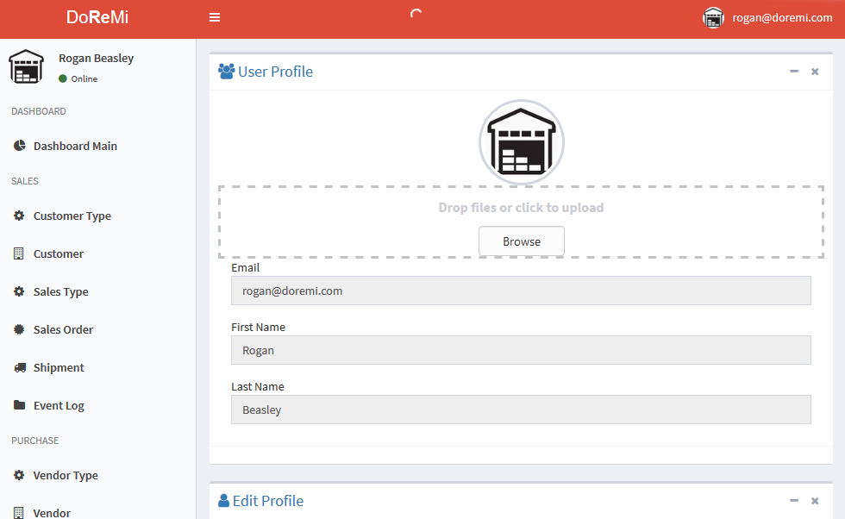
DoReMi Online Order Management System
DoReMi’s Web URL link is :
https://doremiwebapp.azurewebsites.net/
Click the above hyper link to navigate to DoReMi’s online order management system’s sign-on web page.
Signing On
STEPS:
Enter your email address and click the Sign In button to proceed.
You will see the user profile screen if you are successfully signed on.
Sign In Button
Page 2

Slide 4
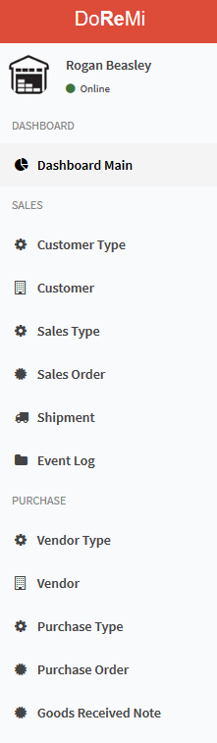
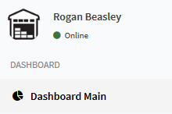
DoReMi Online Order Management System
All users would have similar limited look and feel of the web user interface.
However, each user will have access only to the features or functionality of the system based on what role there are assigned to.
On the left is a typical menu bar accessible to every user of the system.
DASHBOARD
The Dashboard on DoReMi’s web system contains a summary graphical views of some common data information that is useful to sales, operations and finance teams.
To access the Dashboard, click the Dashboard Main link.
Page 3

Slide 5
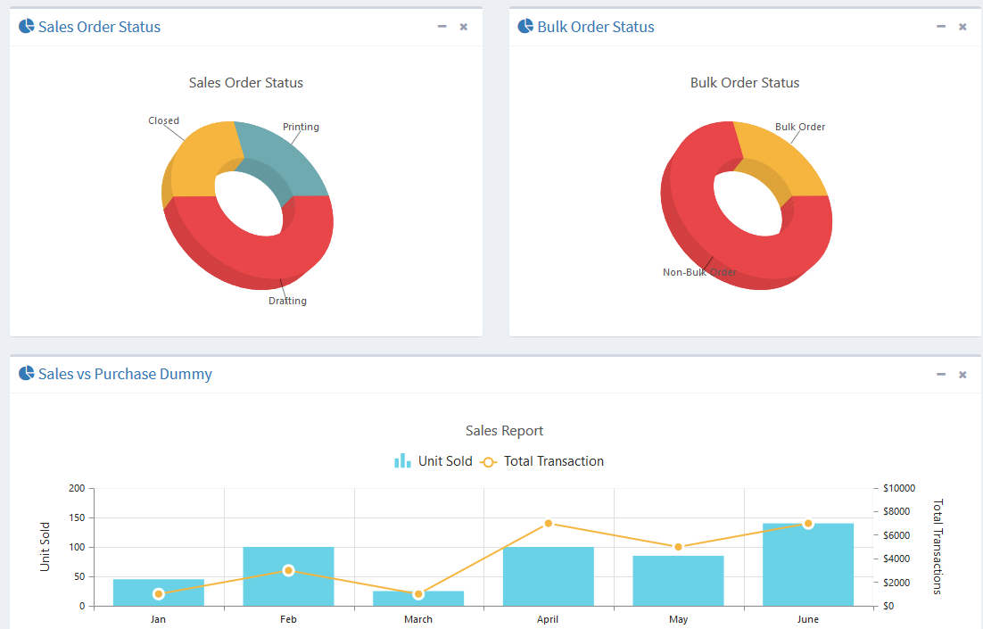
DoReMi Online Order Management System
Dashboard Main Sample
There are basically three key charts made available on DoReMi’s Dashboard.
Sales Order Status
This provides a graphical indication of the number of orders
in various statuses.
Bulk Order Status This is a graphical indication of bulk order versus non-bulk orders.
Sales versus Purchase (Dummy)
- This is not yet implemented. Will be included in phase 2.
Page 4

Slide 6

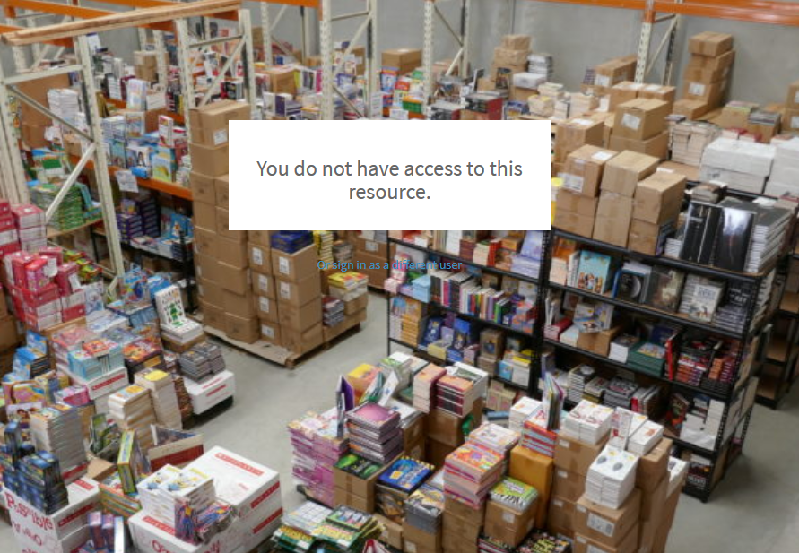
DoReMi Online Order Management System
A user would not be able to view any functionality or feature that is not assigned to him or her. A message will be shown on the page indicating this. See Below.
Click the Back button to get back to the normal menu view.
Page 5

Slide 7
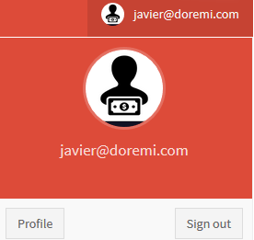

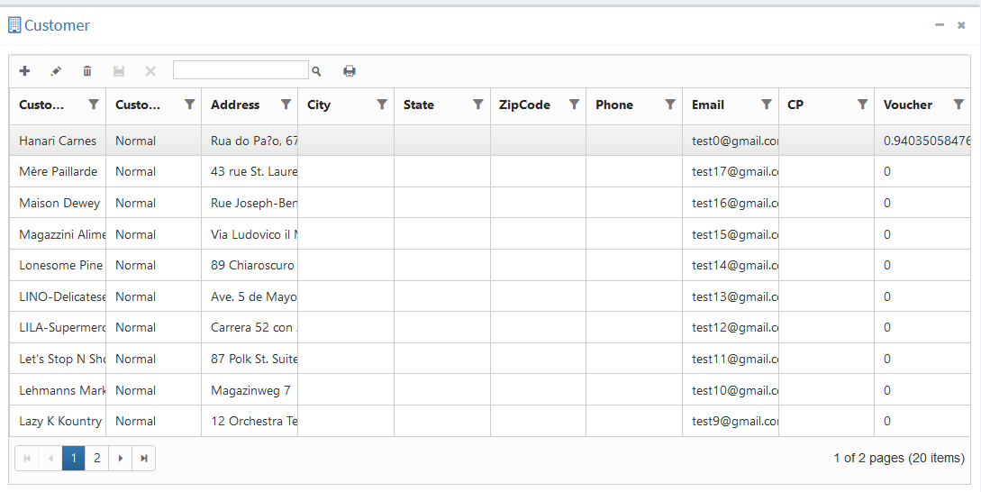
DoReMi Online Order Management System
To Sign out from the System, Click the User Profile Icon and select Sign Out link.
CUSTOMER MASTER
The customer master contains the
main customer account information data.
Only user that are assigned to maintain
the customer master may add or update this records.
Sign Out Button
Page 6

Slide 8
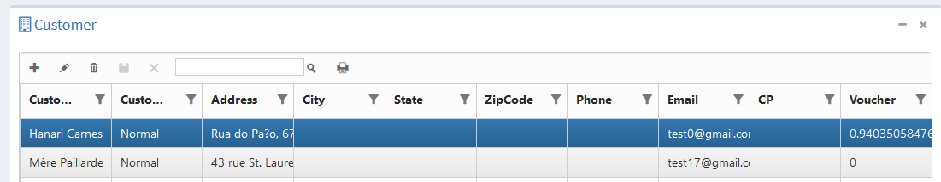

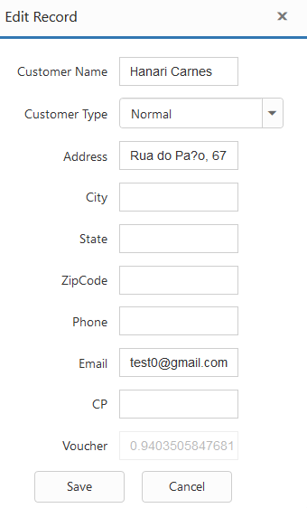
DoReMi Online Order Management System
EDIT AN EXISTING CUSTOMER RECORD
To edit an existing customer record, select a record from the list of records on the customer master screen.
Click the pencil icon. A dialog pops up
With the data fields that you may amend.
Make the changes required and click the
Save button to save the changes.
Edit Button
The unique identifier for each customer record is the customer’s email address.
However, the system does have an internal customer number that is use for internal tracking purposes only.
Page 7

Slide 9
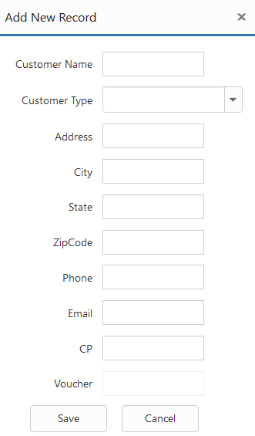
DoReMi Online Order Management System
ADD A NEW CUSTOMER RECORD
To add a new customer record, click the “+” icon on the top bar of the customer master listing.
Enter the required data into the customer form
And click the Save button to update the record.
Click the Cancel button if you do
not wish to save the record.
Add New “+” Icon
Save Button
Page 8

Slide 10

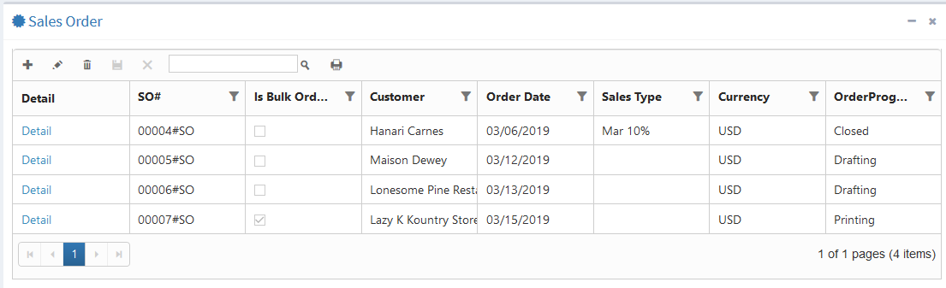
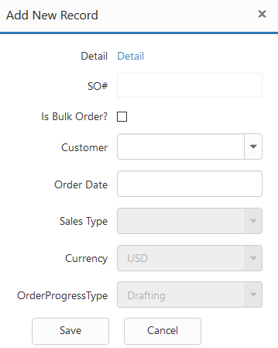

DoReMi Online Order Management System
ADD A NEW SALES ORDER
A customer service representative or a sales person would be able to create a new sales order on DoReMi’s online order management system.
To do this, select the Sales Order from the left menu bar and click on the “+” icon to start a new sales order.
Add New “+” Icon
Enter the require data into the fields provide as shown on the po-up dialog box (Right).
If the sales order is a bulk order, make sure you checked the “Is Bulk Order?” checkbox.
Make sure you select the customer, this sales order is to be assigned to.
The first status for a new sales order is always “Drafting”. The sales order number will be automatically assigned by the system.
Page 9

Slide 11
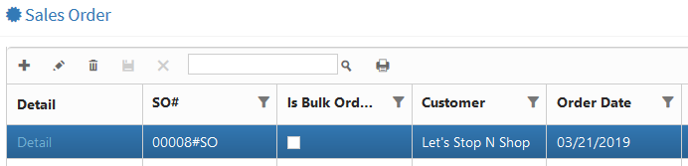
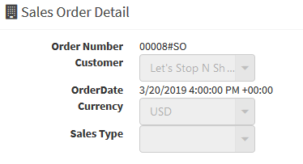

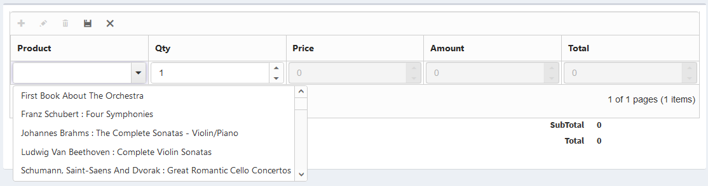
DoReMi Online Order Management System
Please note that creating a sales order consist of 2 steps process. After creating a parent record, you are required to add in products for the sales order.
This you will do so by select the “Detail” link that is shown on the parent record.
Save Icon
To add a new product to a new sales order, click the “+” icon and enter the necessary data into the fields provided on the inline entry fields. Click the Save Icon to update the record. The selling price and total amount will be computed once the record is saved.
Page 10

Slide 12

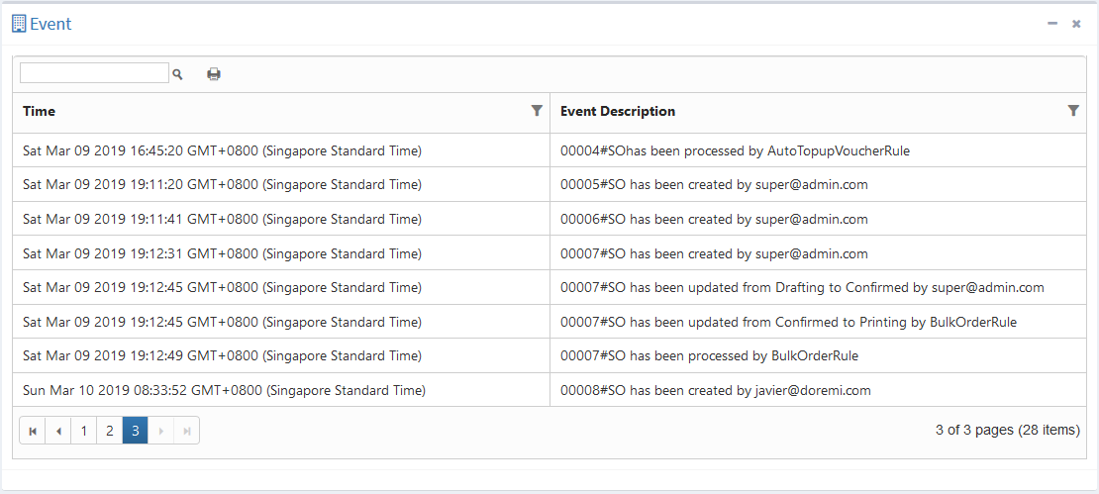
DoReMi Online Order Management System
EVENT LOGS
The system provides a quick and useful mean of checking all activities that were performed by different users for traceability and for audit purposes. A user may easily check his activity logs using the “Event Log” feature.
You may see a list of activities by selecting the Event Log item from the left menu bar.
Page 11

Slide 13
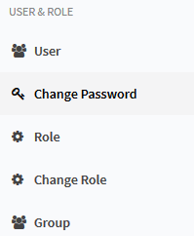
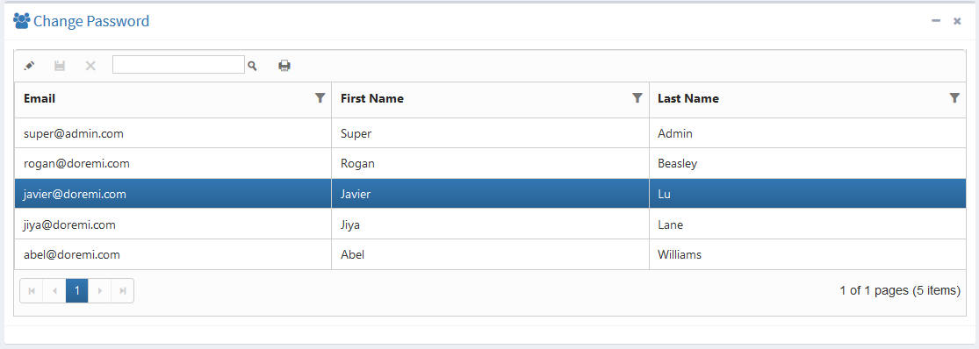
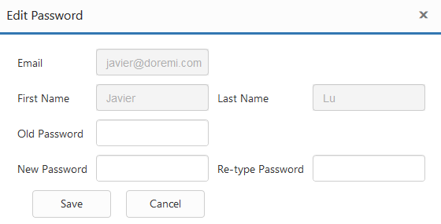
DoReMi Online Order Management System
CHANGE PASSWORD
Any user may conveniently change his / her account password by select the “Change Password” feature from the left menu bar shown on the right.
Select your account from the list of account below and click the “Edit icon” to proceed.
Enter your old password,
new password in the fields
Provided in the dialog box
shown on the screen. Click
The Save button update the changes.
A normal user may not access the (1) User, (2) Role, (3)Group or (4) Change Role features of the system. This can only be administered by the system administrator (Super User).
Page 12

Slide 14
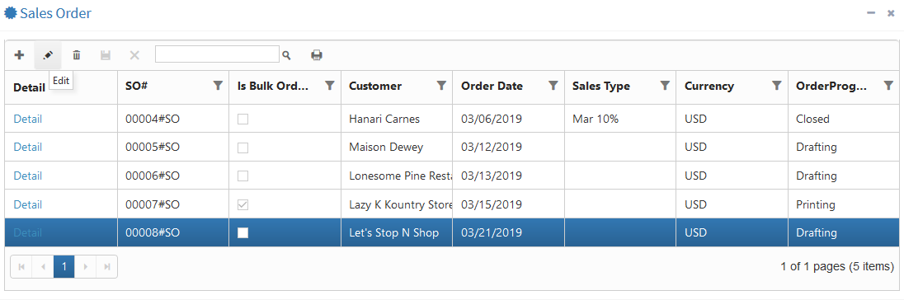
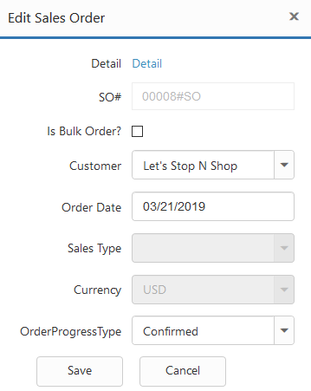
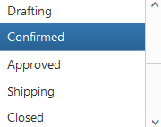
DoReMi Online Order Management System
Edit Icon
SALES USER – CONFIRMS A SALES ORDER
A user in Sales department may confirm a new sales order by executing the following steps:
Select the Sales Order item on the left menu bar.
Click the Edit icon on the top menu of the sales order listing.
Choose “Confirmed” from the Order Progress Type drop down menu.
Click the Save button to update the changes.
At this stage, the system’s Rules Engine would be fired and checks if the stock’s inventory has sufficient balance quantity to fulfil the quantity ordered for each product line item in the sales order. It will also check is discounts needs to be applied to the sales order and finally, check if the system can automatically approve the confirmed sales order based on the pre-set auto-approval limits of each customer.
If the order is auto-approved, an email notification would be sent to the packing team to start their process of packing the picked products from warehouse.
If the order is NOT auto-approved, an email notification would be sent to the Accounts department to follow up on credit risk checks on the sales order’s customer.
If the customer’s credit risk is cleared, the order gets approved and the process continues to the packing team in warehouse.
Page 13

Slide 15
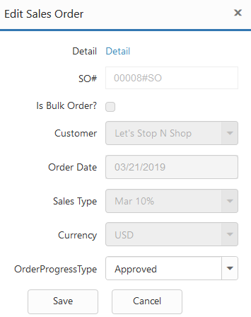
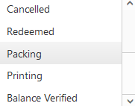
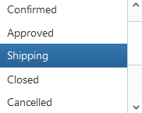
DoReMi Online Order Management System
PACKING TEAM USER – “Packing” status
For any approved sales orders, the packing team is automatically informed via email.
A packing team user will need to access that sales order via the system and update it to the next status of “Packing”
Do note that when the rules engine execute the rules logic, it will execute some interim changes in the status updates before reaching the approved status.
That interim status is “Balance Verified”.
This MUST NOT be selected for updating a sales order’s status.
See flow chart diagram:
Sales Order Transaction Process Flow Chart v2.0.pdf
at git hub:
Once packing of products is completed by the packing team, the products /goods are ready for shipping. The packing team user updates the sales order status to “Shipping”.
Assuming that the shipment gets delivered to the customer. The logistic provider would proceed to update their tracking system and they would have an interface to our WEB API which then updates DoReMi’s system’s sales order status to “Closed”.
This completes a typical sales order cycle in DoReMi’s business work flow.
https://tinyurl.com/y667ucum/Sales_Order_Transaction_Process_Flow_Chart_v2.0.pdf
Page 14

Slide 16
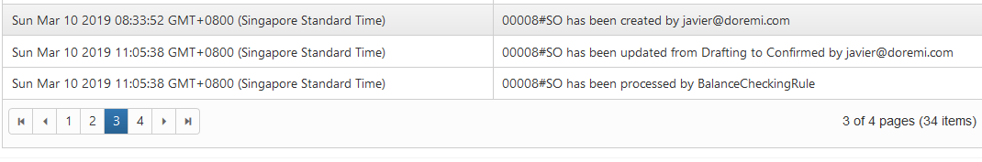
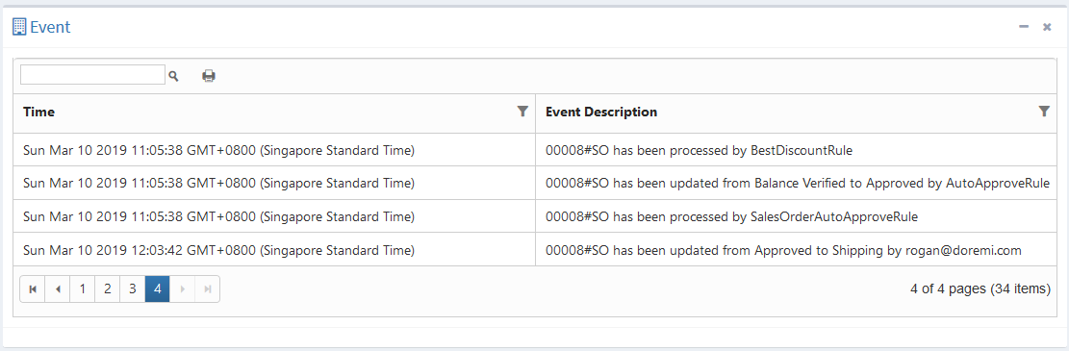
DoReMi Online Order Management System
A TYPICAL EVENT LOG FOR A STANDARD SALES ORDER
In this user guide example which we use sales order number “00008”, you can see the sales order was check with ”BalanceCheckRule” rule. It was then processed by the “BestDiscountRule” rule and the ordered quantity is verified by the “AutoApprovedRule” rule.
Subsequently, the order is automatically approved based on the “SalesOrderAutoApproveRule” Rule.
Page 15

Slide 17
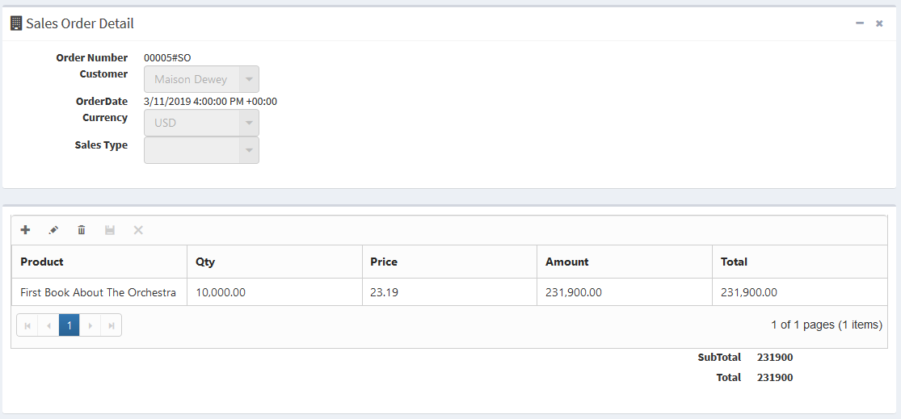
DoReMi Online Order Management System
WHEN A SALES ORDER QUANTITY EXCEEDS THE INVENTORY STOCK’S BALANCE
In this simple example, we are looking at the sales order number “00005”.
You can clearly see that the ordered quantity is 10,000 pcs. However, there is clearly insufficient quantity in the warehouse to fulfil this order.
As such, when the order was confirmed, the “BalanceCheckRule” rule executed its logic and cancelled the order and sent out an email to notify the sales and customer service teams. In this example, it is most likely a typing error that was entered into the quantity field.
This is just an example to high light how the rules are working in the system. Without the rules engine, the error could have potentially created unnecessary jobs for the packing team which means lost or revenue for DoReMi.
Events Log
Sales order detail screen
Page 16

Slide 18
DoReMi Online Order Management System
KEY CONTACT PERSONS
This user guide prepared by: DoReMi’s IT Department (Jerry Jason)
For any enquiry on this guide, please contact Jerry at 451 76428 ext. 212, email: jerryj@doremi.com.
For any systems related support, please contact Tim Grey at 451 76429 ext. 213, email: timg@doremi.com.
For any enquiries on credit risks issues for cancelled orders, please contact the Account department and look for Jamie Lawson at 451 76420 ext. 106, email: jamiel@doremi.com.
For any matters related to packing, packaging, and shipping please contact the warehouse packing team at 451 76431 ext. 323, email: packingteam@doremi.com.
Page 17

